Slide 1
Computer architecture
Topic:
A Common Framework of Memory
Hierarchies
Participants:
نتيجة احمد مرتضى(تقانة)
مريم مكواباتيرا(علوم)
ناجاكو زهرة (علوم)

Slide 2
Summaries:
1-Memory Hierarchy
What is Memory Hierarchy?
Levels of Memory
2-Common Framwork for Memory Hierarchies
Where can a block be found ?
Which block should be replaced on a miss ?
What happens on write ?

Slide 3
1-Memory hierarchy
what is a memory hierarchy?
the memory hierarchy separates computer storage into a hierarchy based on response time..

Slide 4
This Memory Hierarchy Design is divided into 2 main types:
External Memory or Secondary Memory – Comprising of Magnetic Disk, Optical Disk, Magnetic Tape i.e. peripheral storage devices which are accessible by the processor
Internal Memory or Primary Memory – Comprising of Main Memory, Cache Memory & CPU registers. This is directly accessible by the processor.

Slide 5
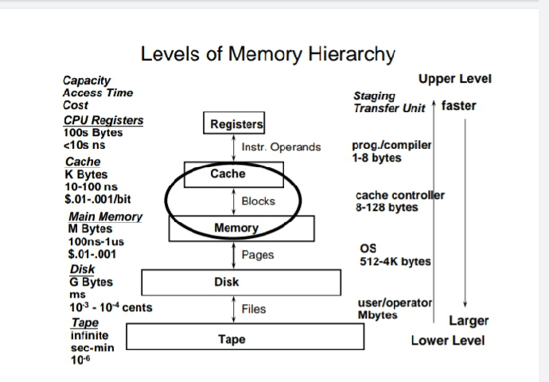

Slide 6
Memory Hierarchy: Principle
● At any given time, data is copied between only two
adjacent levels:
–Upper level: the one closer to the processor
● Smaller, faster, uses more expensive technology
–Lower level: the one away from the processor
● Bigger, slower, uses less expensive technology

Slide 7
Levels hierarchy
There are four levels of memory hierarchy
1-level 0
It contains CPU registers
Level 1
Contains cache memory
Level2
Contains main memory
Level 3
Contains magnetic disk
Level 4
Contains optical disk and magnetic tape

Slide 8
the following are characteristics of Memory Hierarchy Design :
Capacity: It is the global volume of information the memory can store. As we move from top to bottom in the Hierarchy, the capacity increases.
Access Time The access time in the memory hierarchy is the interval of the time among the data availability as well as request to read or write. Because whenever we shift from top to bottom inside the memory hierarchy, then the access time will increase

Slide 9
Ability The ability of the memory hierarchy is the total amount of data the memory can store. Because whenever we shift from top to bottom inside the memory hierarchy, then the capacity will increase. Cost per bit When we shift from bottom to top inside the memory hierarchy, then the cost for each bit will increase which means an internal Memory is expensive compared with external memory.

Slide 10
Memory Hierarchy Design
Registers the register is a static RAM in the processor of the computer which is used for holding the data word which is typically 64 or 128 bits. The program counter register is the most important as well as found in all the processors. Most of the processors use a status word register as well as an accumulator. A status word register is used for decision making, and the accumulator is used to store the data like mathematical operation. Usually, computers like complex instruction set computers have so many registers for accepting main memory.

Slide 11
Cache Memory Cache memory can also be found in the processor. The cache holds data which are frequently used from main memory.it Is the farstest memory located between main memory and CPU registers
Main Memory The main memory in the computer is the memory unit in the CPU that communicates directly. It is the main storage unit of the computer. This memory is fast as well as large memory used for storing the data throughout the operations of the computer. This memory is made up of RAM as well as ROM.

Slide 12
Disks and magnetic tape
They are used to store very large programs and backup information or data because they have very large capacity
Advantages of Memory Hierarchy The need for a memory hierarchy includes the following. -Memory distributing is simple and economical -Removes external destruction -Data can be spread all over

Slide 13
● Block: basic unit of information transfer
–Minimum unit of information that can either be present or not present in a level of the hierarchy
The unit of data that is transferred between two levels is fixed. in size and is called a block, or a line.

Slide 14
2-Common framework for memory hierarchy
A common framework for memory can be explained by the following questions.
a-Where can a block be found ?
Block placement in the upper level of the hierarchy can use a range of schemes, from direct mapped to set associative to fully associative.
In Direct mapping, assigne each memory block to a
specific line in the cache. If a line is previously taken up by
a memory block when a new block needs to be loaded,
the old block is trashed. An address space is split into two
parts index field and a tag field.
The cache is used to store
the tag field whereas the rest is stored in the main
memory.

Slide 15
c-Which block should be replaced on a miss ?
-When a miss occurs in an associative cache, we must decide which block to replace. In a fully
associative cache, all blocks are candidates for replacement. If the cache is set associative, we
must choose among the blocks in the set. Of course, replacement is easy in a direct-mapped
cache because there is only one candidate.
There are the two primary strategies for replacement in set-associative or fully associative
caches:

Slide 16
■ Random: Candidate blocks are randomly selected, possibly using some hardware
assistance. For example, MIPS supports random replacement for TLB misses.
■ Least recently used (LRU): The block replaced is the one that has been unused for the
longest time.

Slide 17
d- What happens on write ?
A key characteristic of any memory hierarchy is how it deals with writes. We have already seen
the two basic options:
■ Write-through: The information is written to both the block in the cache and the block in the
lower level of the memory hierarchy (main memory for a cache). The caches in Section 5.3
used this scheme.
■ Write-back: The information is written only to the block in the cache. The modified block is
written to the lower level of the hierarchy only when it is replaced. Virtual memory systems
always use write-back, for the reasons discussed in Section 5.7.
Both write-back and write-through have their advantages. The key advantages of write-back
are the following:

Slide 18
■ Individual words can be written by the processor at the rate that the cache, rather than the
memory, can accept them.
■ Multiple writes within a block require only one write to the lower level in the hierarchy.
■ When blocks are written back, the system can make effective use of a high-bandwidth
transfer, since the entire block is written.
Write-through has these advantages:
■ Misses are simpler and cheaper because they never require a block to be written back to the
lower level.
■ Write-through is easier to implement than write-back, although to be practical, a write￾through cache will still need to use a write buffer.

Slide 19
http://www.cs.washington.edu/homes/snyder/
Referrencies:

